Slide 1
Diagnostic Questions (Maths)
On the following slides you will find a total of 10 Maths questions to have a go at.
Each question has 4 multiple choice answers to choose from; one of them is the correct answer.
Work out which answer you think is correct and write it down in your exercise book.
The correct answers will be given to you in next week’s Diagnostic Questions PowerPoint so you can mark your work.

Slide 2
Answers to Last Week’s Questions
1. A
2. A
3. D
4. A
5. A
6. D
7. D
8. B
9. D
10. A

Slide 3
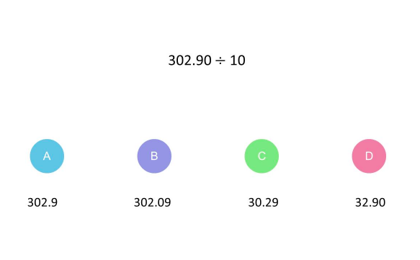
1.

Slide 4
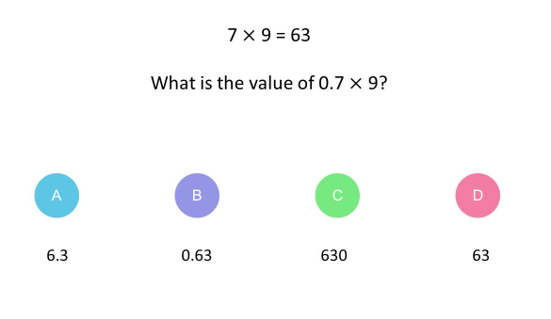
2.

Slide 5
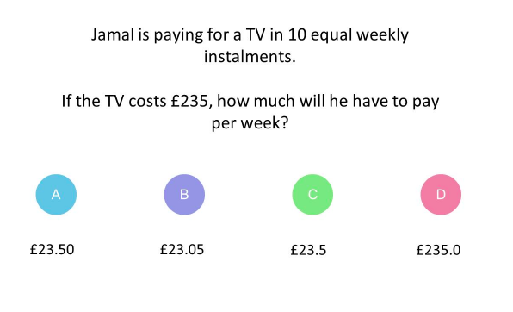
3.

Slide 6
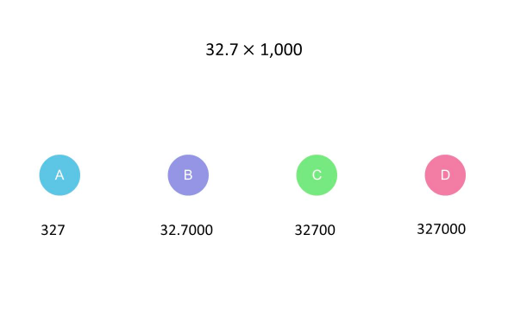
4.

Slide 7
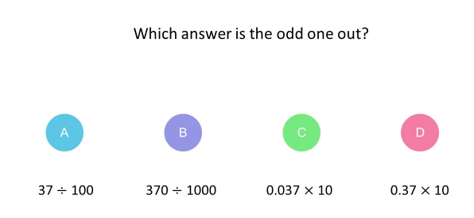
5.

Slide 8
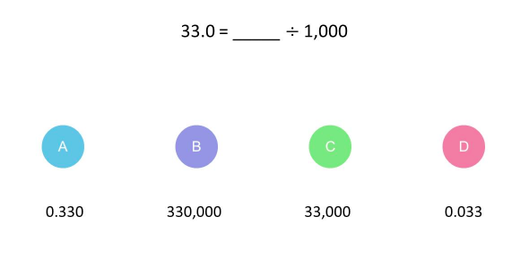
6.

Slide 9
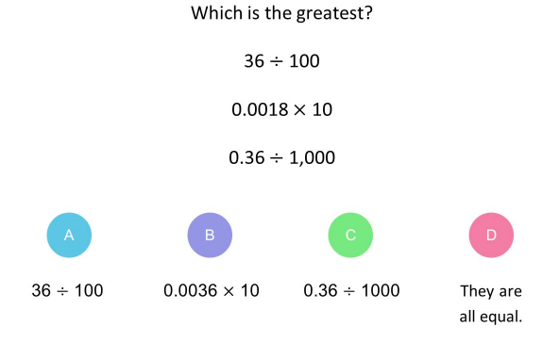
7.

Slide 10
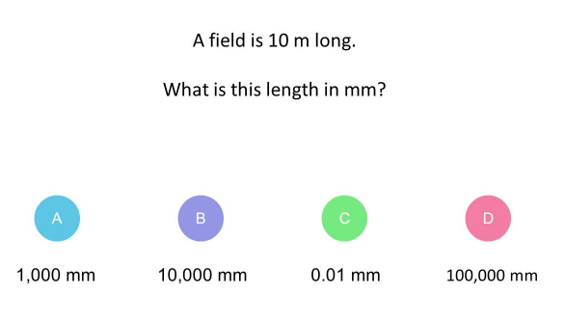
8.

Slide 11
9.

Slide 12
10.

Slide 13
Answers to this Week’s Questions
1. C
2. A
3. A
4. C
5. D
6. C
7. A
8. B
9. C
10. C

